Slide 1
NYC TAXI FARE PREDICTION
Group4
Rui Chen, Qiwenjing Jiang, Jialing Li,
Erqian Wang, Zhongyan Wang, Kristine Zeng

Slide 2
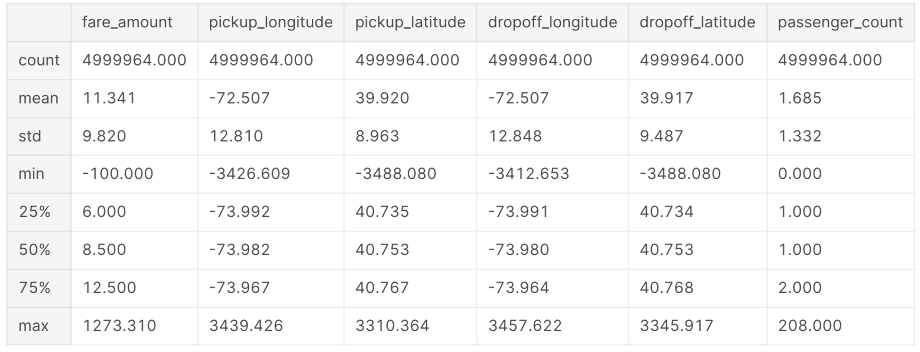
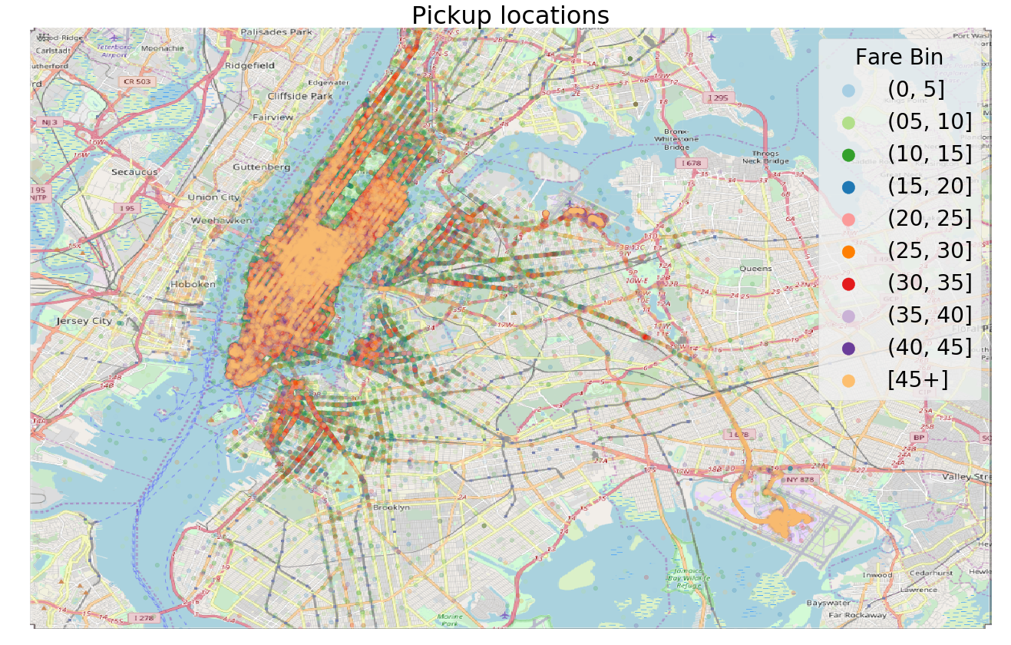
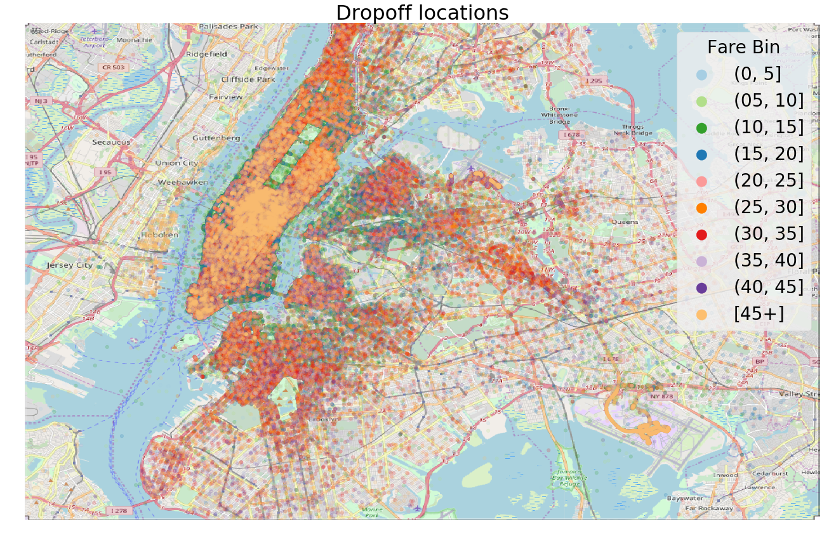
Dataset
Size: 5.7 GB, 55 million rows.
6 Features: pickup_datetime (Dec. 2008 - Jun. 2015), pickup_longitude, pickup_latitude, dropoff_longitude, dropoff_latitude, passenger_count.
Prediction Target: fare amount.
Trips mostly within Manhattan
Data cleaning needed

Slide 3
Feature Engineering Ideas
There are 6 features. We hope to add more features to improve the prediction.
Get more features by utilizing longitude and latitude.
Extract travel distance and time through different APIs (e.g. Google-Maps) based on pickup and dropoff locations.
Could separate timeline into daytime and nighttime (or into different time periods) to see how the fare fluctuates at different time.
Could observe fare rate fluctuations by year.

Slide 4
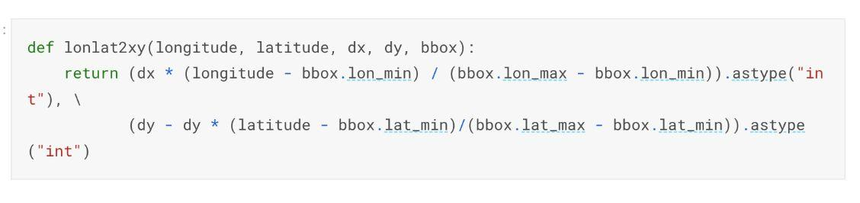
Optimization
Conventionally, the data preprocessing is done by Pandas, which can be slow given the large size of dataset.
We are planning to use what we learn in this class to speed up the preprocessing computation time, such as Cython, Generator, Numba, and some additional packages to calculate the distances.
We will start with the original solution, and use IPython profiler to diagnose the part that runs slow.
Original function to calculate the location

Slide 5
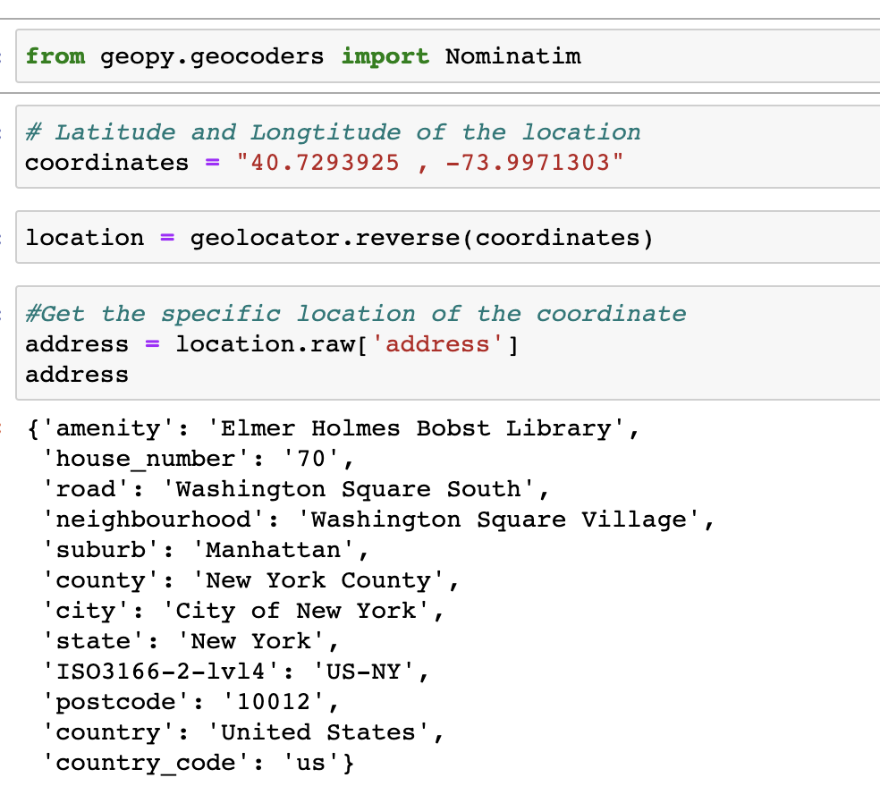
Get specific locations from latitude and longitude
Latitudes and longitudes are not intuitive predictors of locations for somewhere like Manhattan.
We use package geopy to get more specific address information.

Slide 6
Modeling
Try different regression models to predict fare amount.
Linear Regression (with Regularization)
Random Forest
Compare models’ performance.
Ensemble models to see if it can further improve the predictability.

Slide 7
Reference
https://www.kaggle.com/competitions/new-york-city-taxi-fare-prediction
https://www.kaggle.com/competitions/new-york-city-taxi-fare-prediction/overview
https://www.kaggle.com/code/willkoehrsen/a-walkthrough-and-a-challenge
https://geopy.readthedocs.io/en/stable/#nominatim

